Slide 1

Style Your Web Apps, Office & SharePoint Add-ins with Office UI Fabric
Andrew Connell
@andrewconnell
www.andrewconnell.com
Level: Intermediate

Slide 2






Andrew Connell
www.AndrewConnell.com
me@AndrewConnell.com
@andrewconnell
Full stack web developer & instructor
Co-host, Microsoft Cloud Show – www.MicrosoftCloudShow.com
Hands-On SharePoint Training Critical Path Training - www.CriticalPathTraining.com
On-Demand SharePoint Training Pluralsight – www.Pluralsight.com

Slide 3
Topics
Challenges Extending Office & SharePoint
Introducing Office UI Fabric
Demo-ganaza!

Slide 4
Challenges Extending Office & SharePoint

Slide 5
Building Custom Apps
What should it look like?
How to implement the UI?
Bootstrap?
Material?
Third Party Vendor?

Slide 6
Bootstrap
Originated from Twitter
Community driven / maintained
CSS based
Marketplaces
https://wrapbootstrap.com
http://getbootstrap.com http://themes.getbootstrap.com

Slide 7
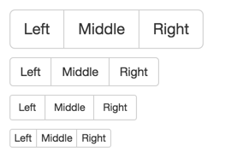
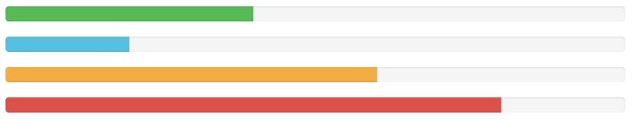
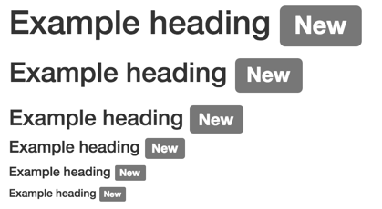
Bootstap Examples

Slide 8
Bootstrap in Apps

Slide 9
Material Design
Google’s design language
Used across all Google properties
Web properties
Android
Chromecast
No official implementation; bootstrap theme
http://www.google.com/design/spec/material-design

Slide 10
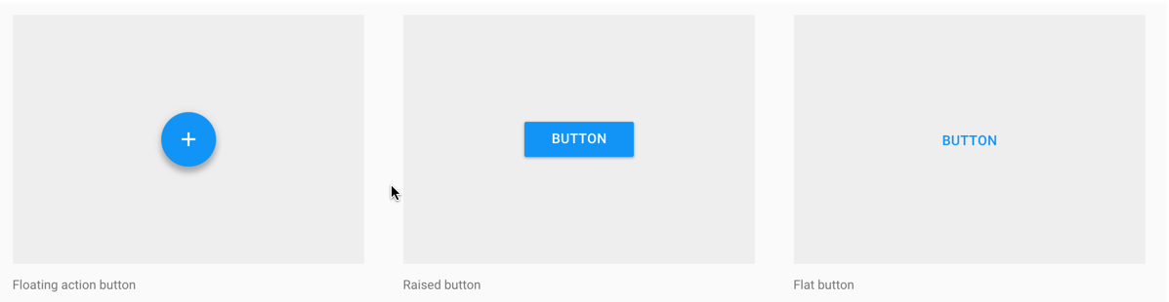
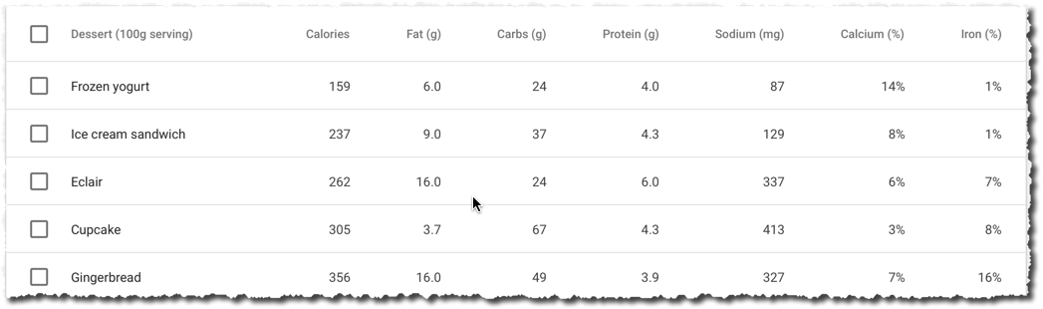
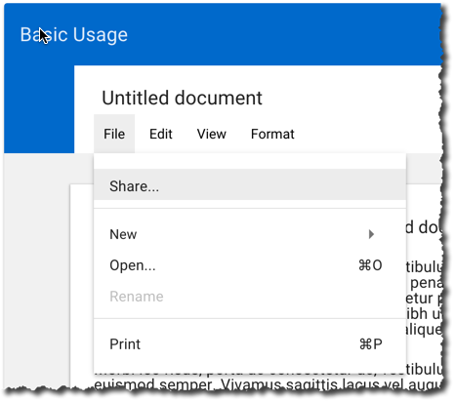
Material Design Examples

Slide 11
Material Design in Office Add-ins

Slide 12
Challenges…
Do you want your custom apps to look
The same as Office 365 / Office / SharePoint?
Different from Office 365 / Office / SharePoint?
Leverage the fact your users are familiar with Office 365 / Office / SharePoint!

Slide 13
Introducing Office UI Fabric

Slide 14
Office UI Fabric
Collection of CSS classes implementing various UI controls in Office, Office 365 and related products
Some components require JavaScript
Includes color pallets, icons, typography, animations
Open source

Slide 15
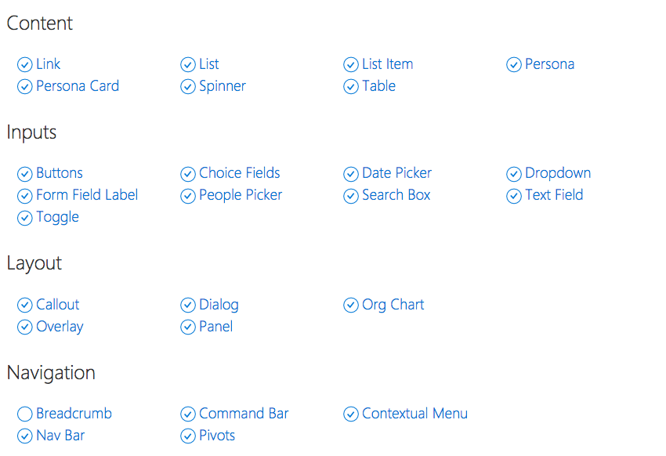
Included Components

Slide 16
Where to Get it?
https://github.com/OfficeDev/Office-UI-Fabric
http://dev.office.com/fabric

Slide 17
Demos!
http://dev.office.com/fabric
http://codepen.io/andrewconnell

Slide 18
What’s Next?

Slide 19

ngOfficeUIFabric
Angular directives for Office UI Fabric components
Community project
http://ngofficeuifabric.com
Discussions & Updates
http://slack.ngofficeuifabric.com

Slide 20

Thanks! Questions?
github.com / andrewconnell / pres-intro-office-ui-fabric

